Slide 1


Python Webapp Programming
Questionnaire app with Django
--Form, Django edit views

Slide 2
New function: view the results
Currently we still not develop the function for user to participate the questionnaire yet, but we can add the view function first as this function is relatively simple.

Slide 3
Config the URL for viewing result
Add new URL for ‘/result/<int:pk>/’

Slide 4
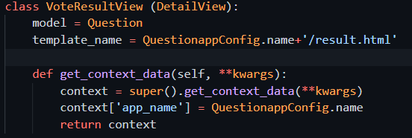
Add view for checking result
The new view also from the DetailView.
The main content is based on Question, although it added vote results. So it is using model Question’s detail (one item of Question).

Slide 5
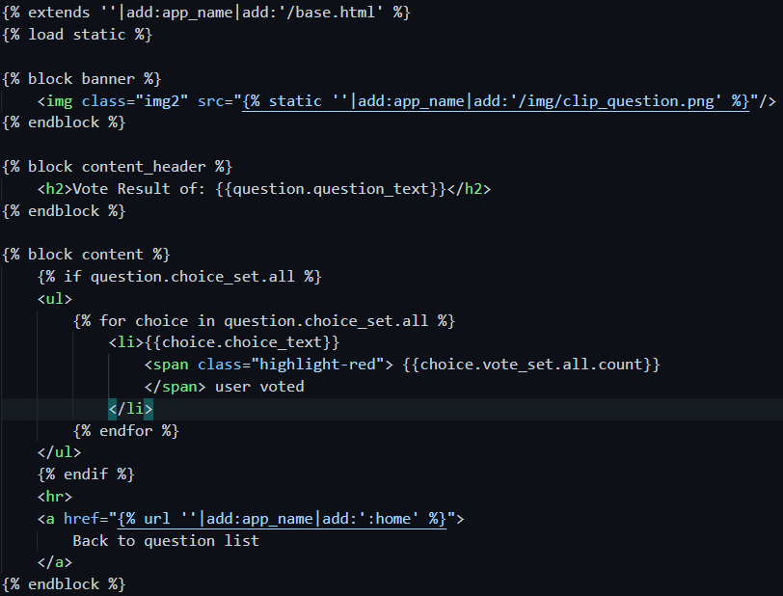
Add template
Exntends from base.html
All content similar to detail template. Only added how many users opt for the choice, and we show the text in red larger size.

Slide 6
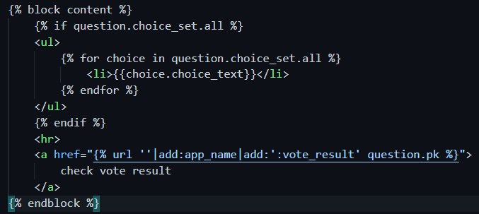
Change detail template a button to view result
At each question detail page, add one link to check the result.

Slide 7
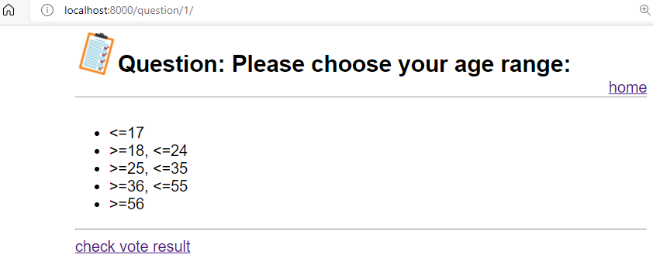
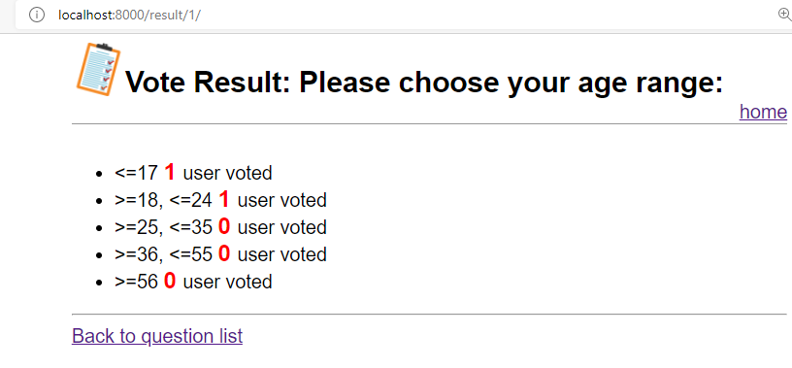
From the browser

Slide 8
Add new function for user to add comment or feedback
Before we start to let user participate the questionnaire, we first develop the function for user to add comment/feedback.

Slide 9
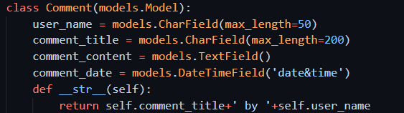
Add model to store the comment in DB

Slide 10

Register DB to admin app, readonly

Slide 11
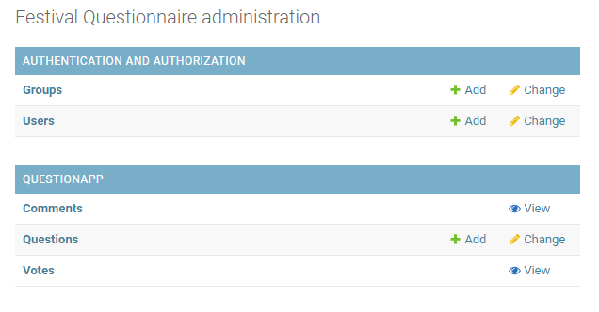
Check the db
PS> 2myprj
PS> pipenv shell
PS> cp QuestionPrj
PS> py manage.py makemigrations QuestionApp
PS> py manage.py migrate
Open admin and check

Slide 12
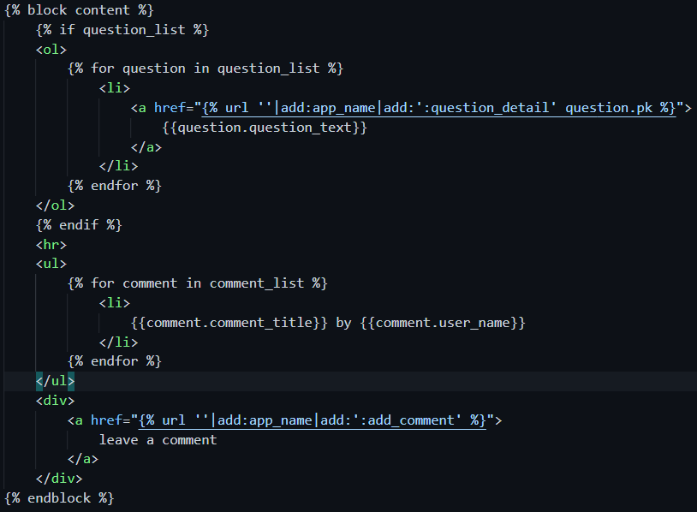
Add one comment button to the home page
Add button which links to add comment
Also added showing all comment information in the homepage, after the question list.

Slide 13
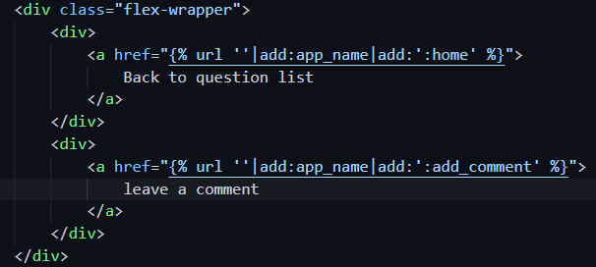

Add one comment button to the result page
Add the class flex-wrapper, for the added clickable of leave a comment

Slide 14
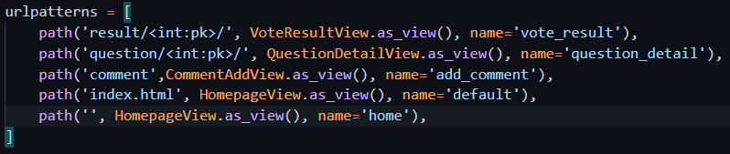
Add url conf

Slide 15
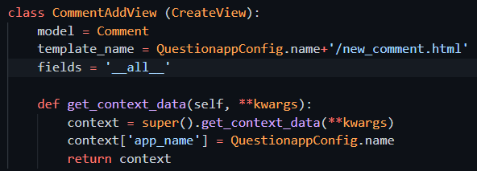
Add view for add comment page
It is using the Django.views.generic.edit, the CreateView. Other views include UpdateView, DeleteView.

Slide 16
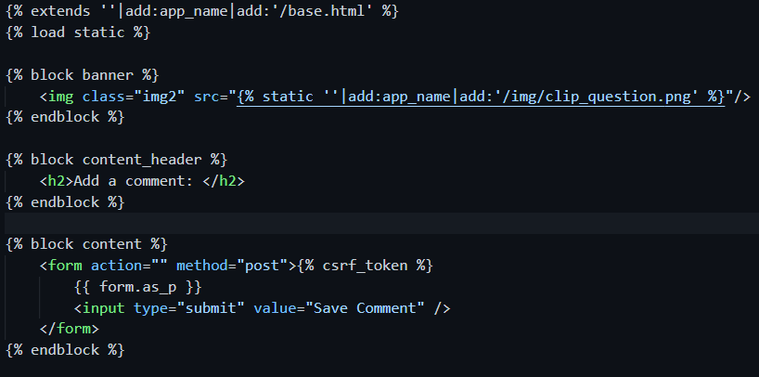
Add template for add comment
The template will use form for user to input and post

Slide 17
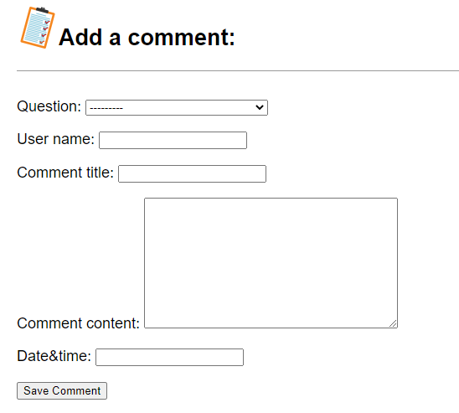
Check the result
We got the form, but for the datetime field, it is like a text we must key in information manually.
The format must be exactly like what shown in picture,
YYYY-MM-DD HH:MM:SS
2020-09-01 20:20:20

Slide 18

But still another issue
When finish a POST action, the webserver should return back a new URL for the browser to view.
As shown by the error information from Django, we can do this by define get_absolute_url for the model which we are modifying. This URL will be the success url for the user after he add the new comment.
Then we add the get_absolute_url, make it go back to the homepage after success submit.

Slide 19
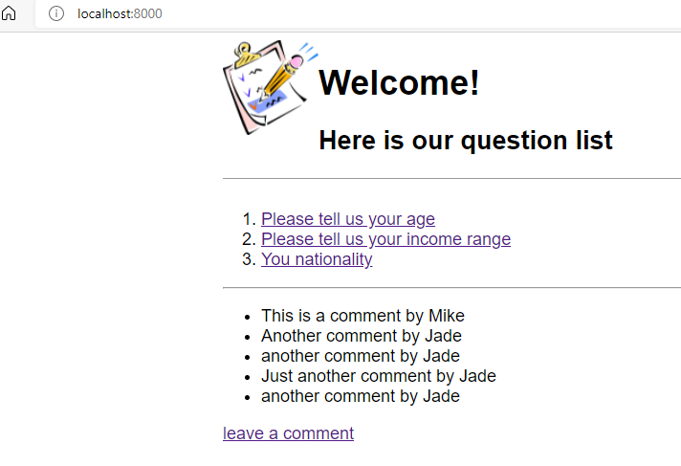
Check the result
After submit a form then it will go back to show the homepage, with the comment updated.

Slide 20
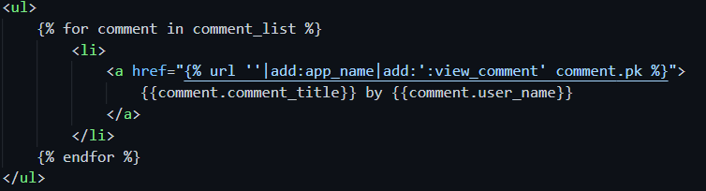
Add edit comment function
At home page for each comment add link to click and see detail of comments.
at detail comments add edit the comment and delete the comment, two button at the bottom

Slide 21
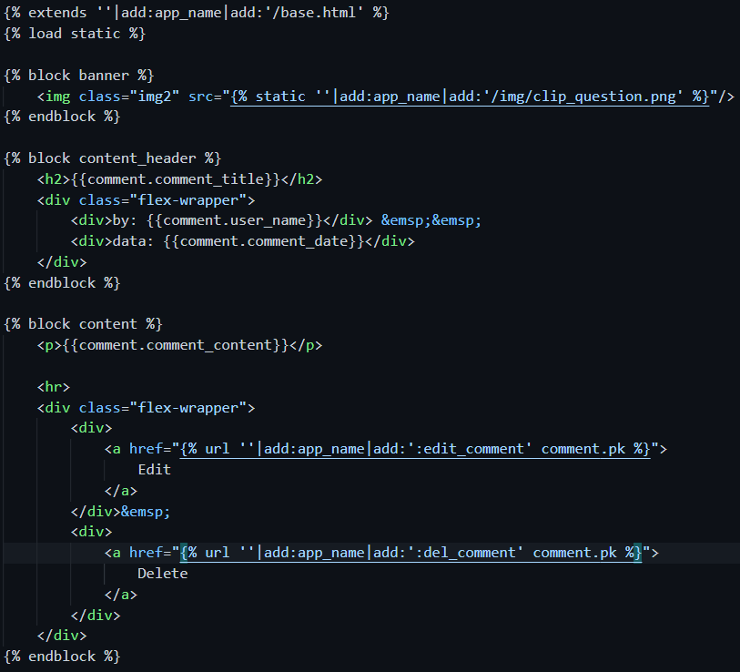
Detail comment

Slide 22
Add url conf
Comment details
Comment edit
Comment delete

Slide 23
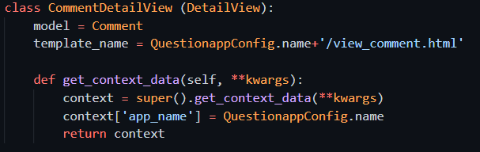
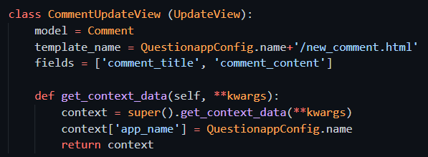
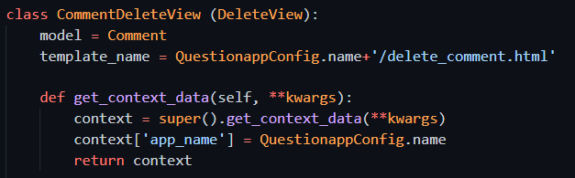
Add view
Comment details
Comment edit
Comment delete

Slide 24
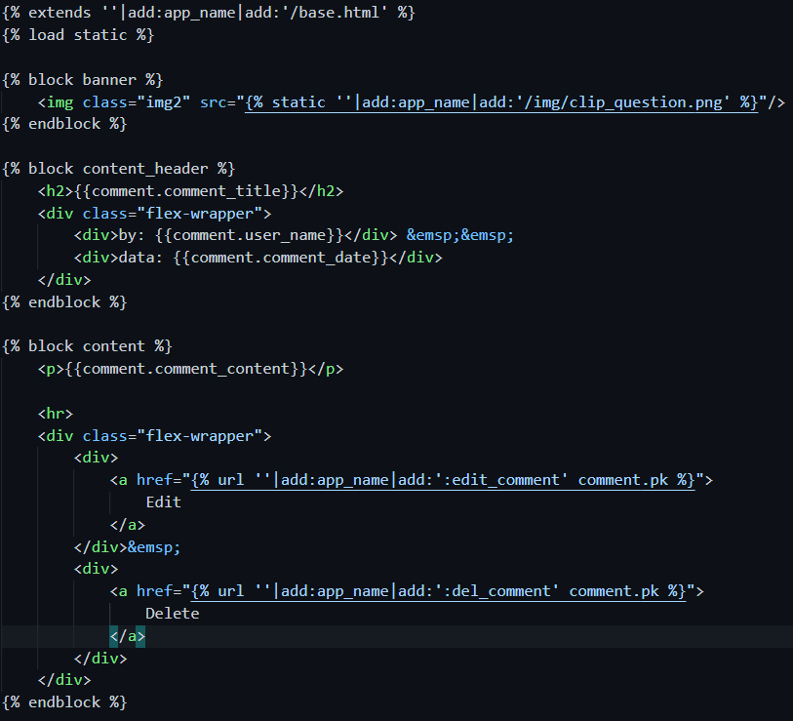
Add template
Comment details

Slide 25
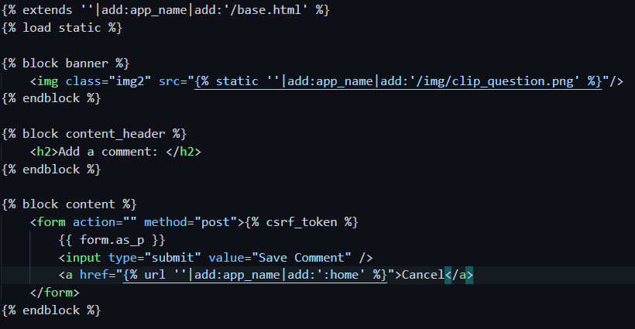
Add template
Comment edit. Same template as add new comment

Slide 26
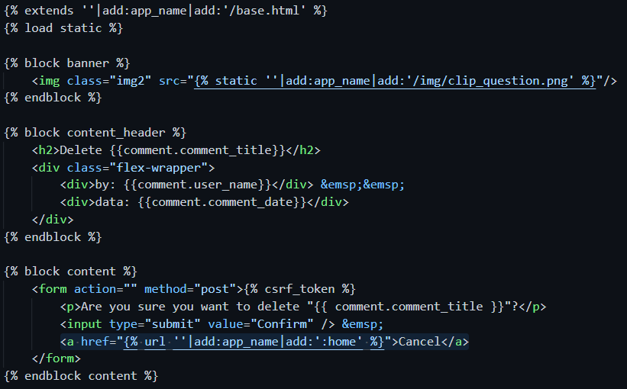
Add template
Comment delete
Add one additional cancel link

Slide 27

Still got one issue when delete
The model function get_absolute_url not working for this deleteview. So need add get_success_url function for the view.

Slide 28
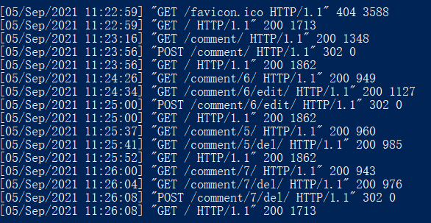
Check the details from server log
Click add comment, browser send this GET
Click on one comment and view the details.
Finish edit the form and click submit, browser send this POST. The add comment successful. Server respond 302
Click edit the comment.
Finish the edit of form, submit the result. Update comment success. Server responde 302
Go to the URL of get_absolute_url
Click one comment view details
Go to the URL of get_absolute_url
Click delete
Click on one comment and view the details.
Click cancel, it links to homepage
Click delete
Click confirm delete. Server process success, respond 302
Goto the URL of get_success_url. Because one comment deleted, so the size smaller.

Slide 29
Deploy to Heroku cloud
Push to git repo
Deploy to heroku
PS> cd 2myprj
PS> git status
PS> git add –A
PS> git commit –m “add static files deploy”
PS> git push origin main
PS> git subtree push --prefix QuestionPrj heroku main
PS> heroku ps:scale web=1

